Slide 1
Equation in Math Make you Loose Fat
by Brandon Lopez

Slide 2
The Program
There are many ways to loose weight, this program involves exercising and cutting calories from your regular meal.

Slide 3
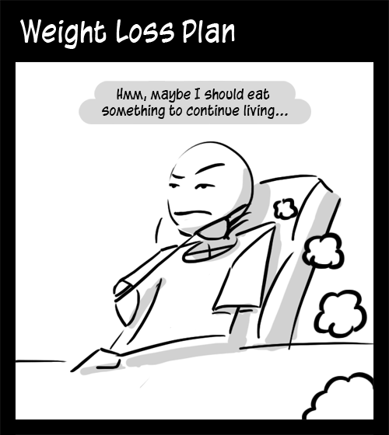
All About Calories
For loosing one pound of fat, you need to loose 3,500 calories.
Loosing calories is the way of loosing fat from your body.

Slide 4
What you need to know?
1. Walking or jogging one mile will make you loose around 100 calories. The rate or the slope of our equation is 100.
2. Cutting back ½ cup of ice cream OR two sugar-sweetened sodas from your meals in a day will make you loose 250 everyday. The constant of the equation is 250.

Slide 5
The Equation and the Variables
Y = 100x + 250
The number of miles you ran everyday:
(Independent Variable) is X.
The number of calories you loose in each day:
(Dependent Variable) Y.

Slide 6
Table
Days | x(values) | y=f(x)
1 | 1 | 350
2 | 3 | 550
3 | 2 | 450
4 | 3 | 550
5 | 4 | 650
6 | 2 | 450
7 | 3 | 550
8 | 1 | 350
9 | 2 | 450

Slide 8
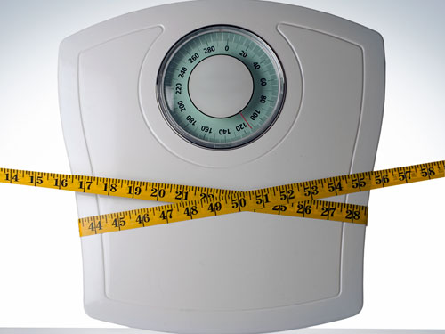
How many pounds I lost so far…
y=f(x)
350
550
450
550
650
450
550
350
450
Adding up all the calories(4350) in those 9 days and divide by 3,500 will tell me how many pounds I lost so far (pounds lost= 4350/3,500)

Slide 9
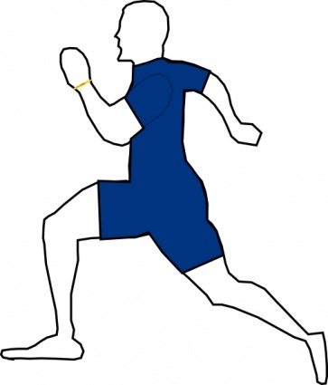
Conclusion
If you want to loose more weight, you need to increase the number of miles you are walking or running everyday.

